Slide 1
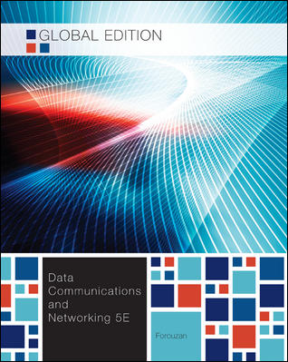
Chapter 17
Chapter 17
Connecting Devices And Virtual LANs
Connecting Devices And Virtual LANs

Slide 2
Chapter 17: Objective
17.1 Connecting Devices
  It first describes hubs and their features.
  It discusses link-layer switches (simply switches).
17.2 Virtual LANs (VLAN)
  How membership in a VLAN can be defined?
  How switches can communicate in a VLAN?
  What are the advantages of a VLAN?
17.3 요약

Slide 3
17.1 Connecting Devices
Connecting devices are used to connect hosts together to make a network, or to connect networks together to make an internet.
Connecting devices can operate in different layers of the Internet model.
We discuss three kinds of connecting devices:
  Hubs
  link-layer switches
  routers.

Slide 4
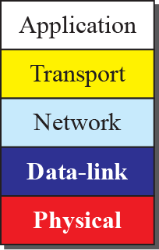
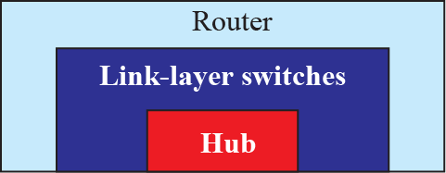
17.1 Connecting Devices
Three kinds of Connecting Devices

Slide 5
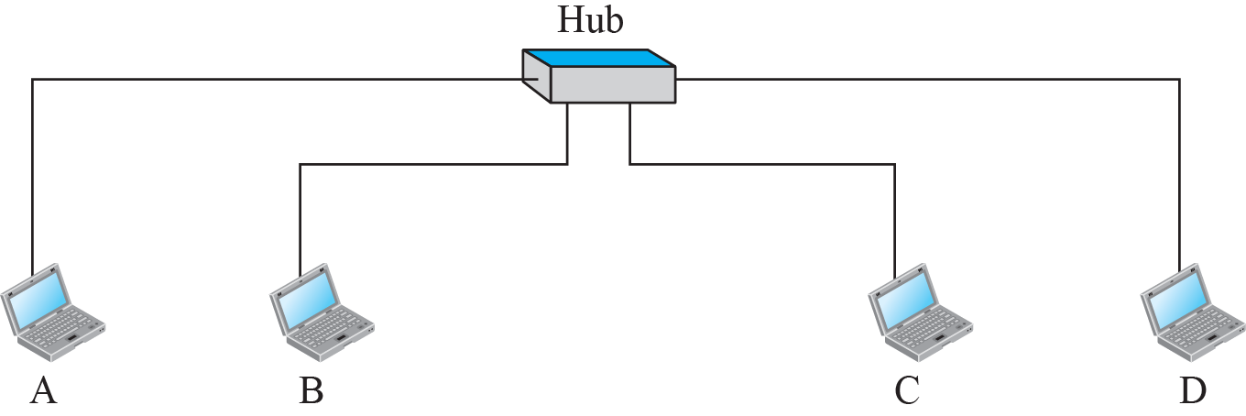
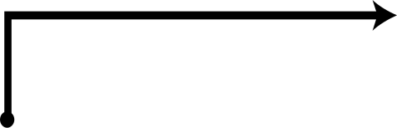
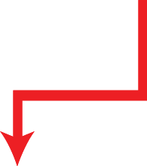
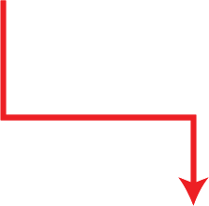
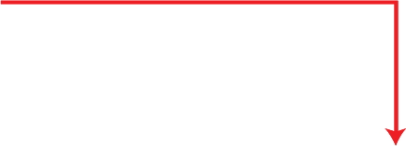




17.1.1 Hub
A Hub is a device that operates only in the physical layer.
  Signals that carry information within a network can travel a fixed distance.
A Repeater receives a signal, regenerates and retimes the original bit pattern.

Slide 6
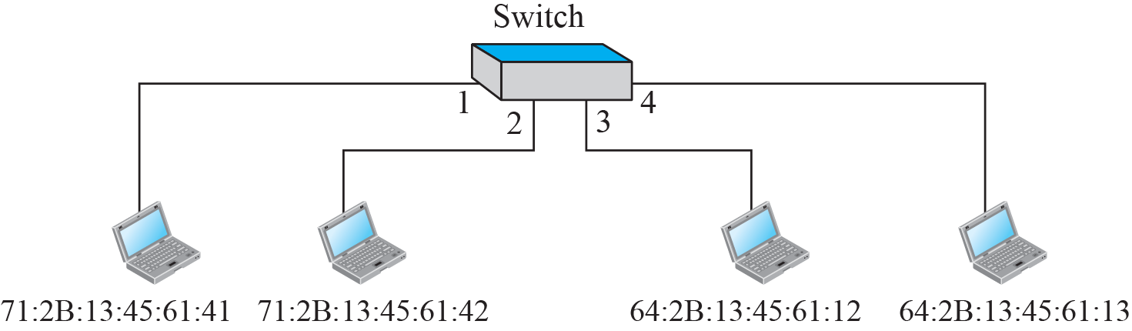
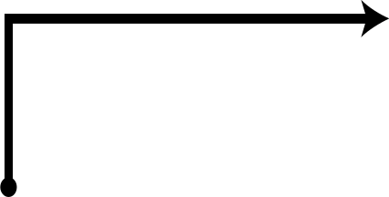
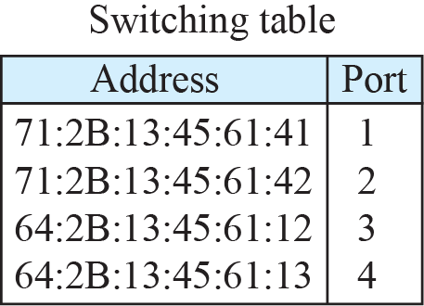
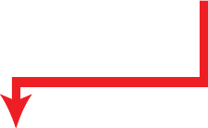
17.1.2 Link-layer Switch
Switch operates in both physical and data-link layers
  It regenerates the signal it receives.
  It checks the MAC addresses (source and destination) contained in the frame.
    Filtering : Which outgoing port the frame should be sent.
    Not change the link-layer (MAC) address in a frame.

Slide 7

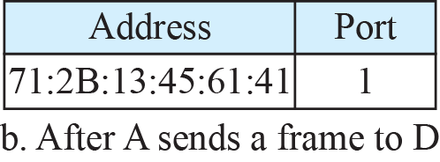
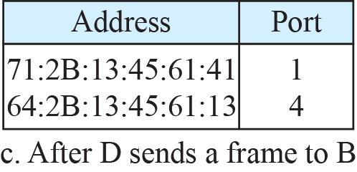
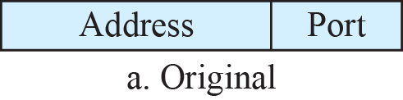
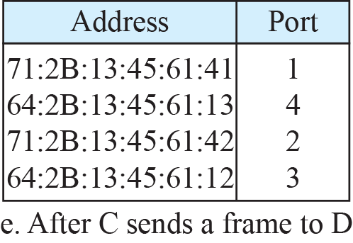
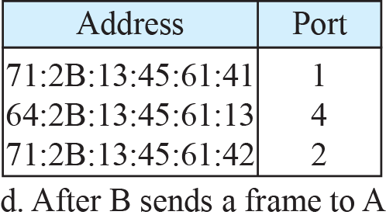
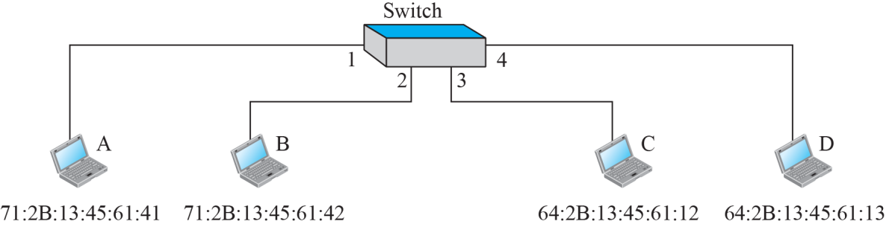

17.1.2 Link-layer Switch
Learning Switch
  It maps MAC addresses to ports (interface) automatically.
  Destination address : used for the forwarding decision.
  Source address : adding entries to the table.

Slide 8
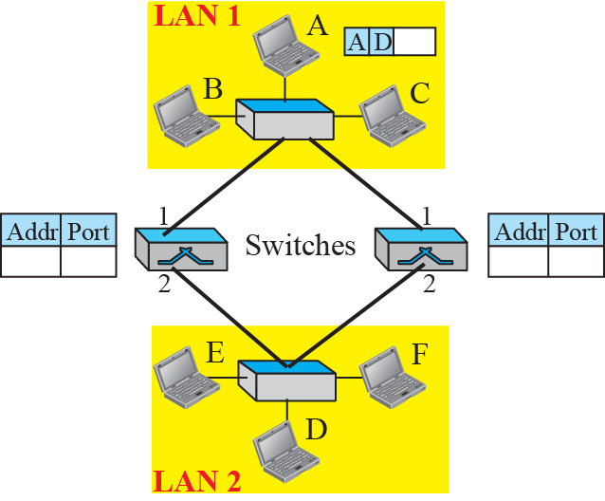
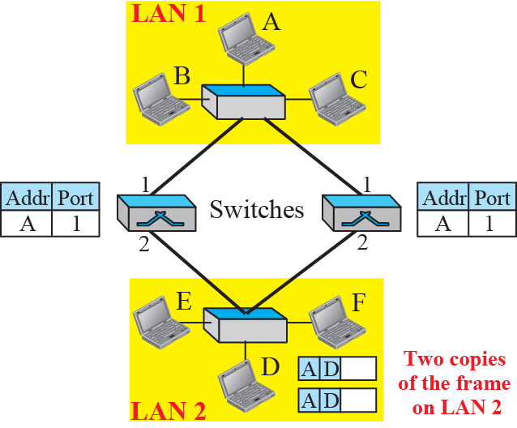
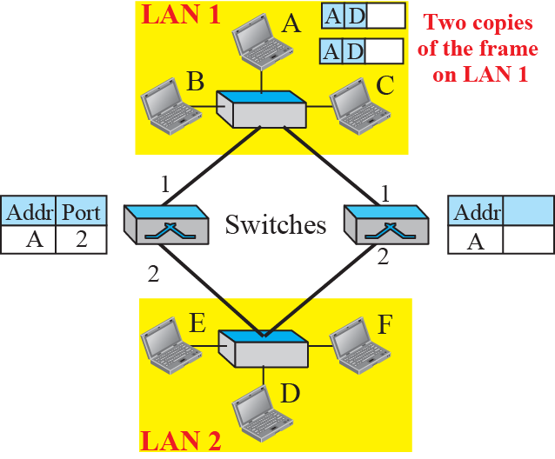
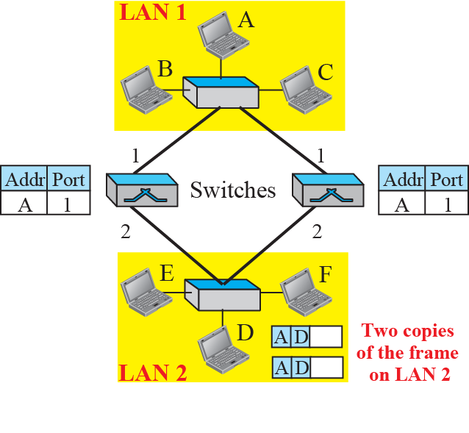
17.1.2 Link-layer Switch
Loop problem in a learning switch

Slide 9
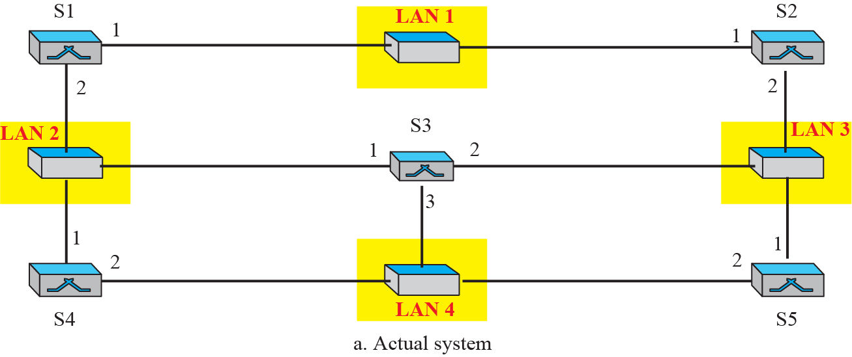
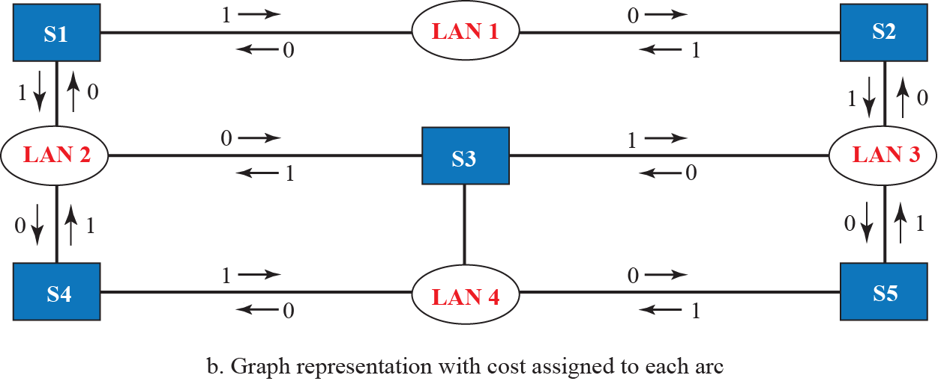
17.1.2 Link-layer Switch
A system of connected LANs and its graph

Slide 10
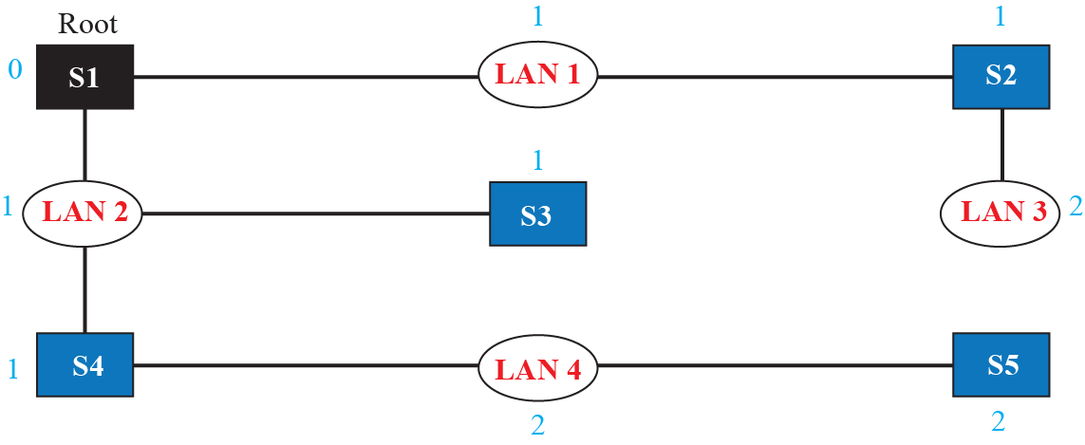
17.1.2 Link-layer Switch
Spanning Tree : a graph in which there is no loop.
Finding the shortest path and the spanning tree for a switch.

Slide 11
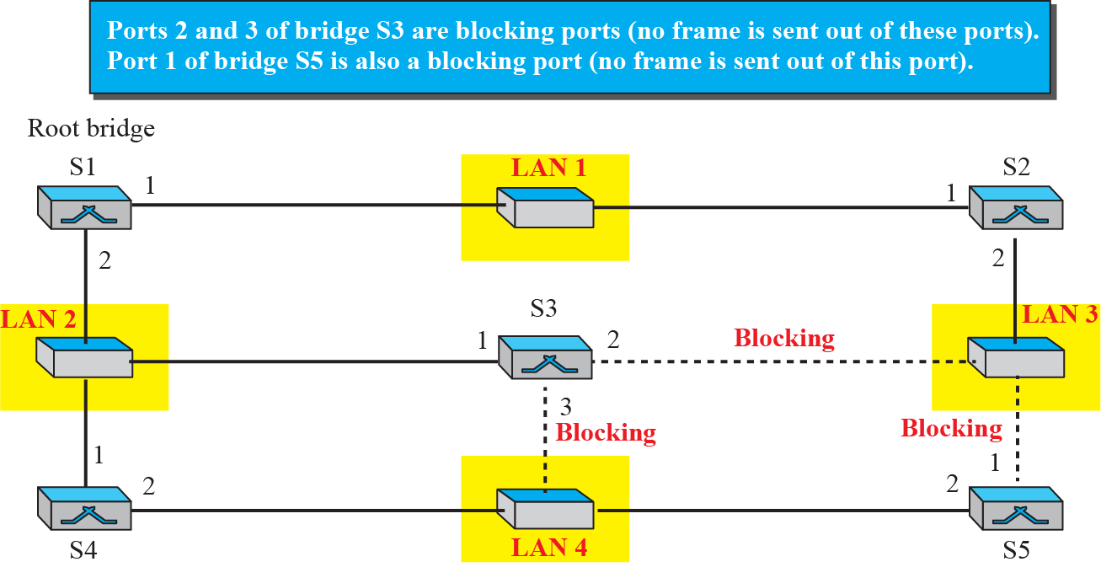
17.1.2 Link-layer Switch
Forwarding and blocking ports after using spanning tree algorithm

Slide 12
17.1.3 Router
A Router operates in three-layer; physical, data-link, and network layer.
  A router can connect networks.
  A router is an internetworking device.
The differences of Router and Switch
  A router has a physical (MAC) and logical (IP) address for each of its interface.
  A router acts only on the packet that the link-layer destination address matches the address of the interface at which the packet arrives.
  A router changes the link-layer address of the packet. (source and destination address)
A router changes the link-layer addresses in a packet.

Slide 13
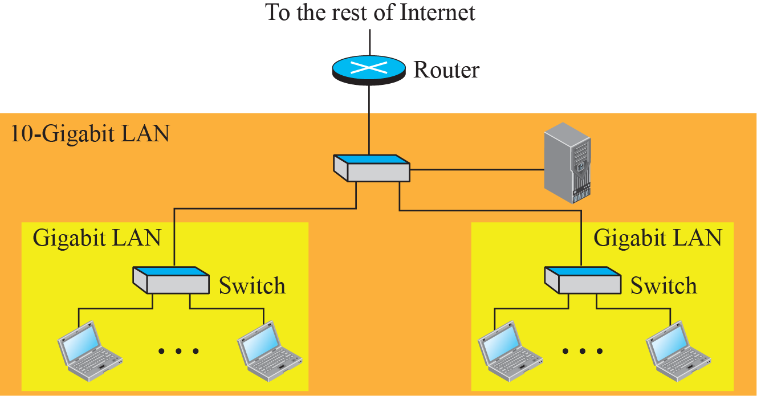
17.1.3 Router
Routing Example

Slide 14
17.2 Virtual LAN(VLAN)
A station is considered part of a LAN if it physically belongs to that LAN.
  The criterion of membership is geographic.
What happens if we need a virtual connection between two stations belonging to two different physical LANs?
Virtual Local Area Network (VLAN)
  a local area network configured by software, not by physical wiring.

Slide 15
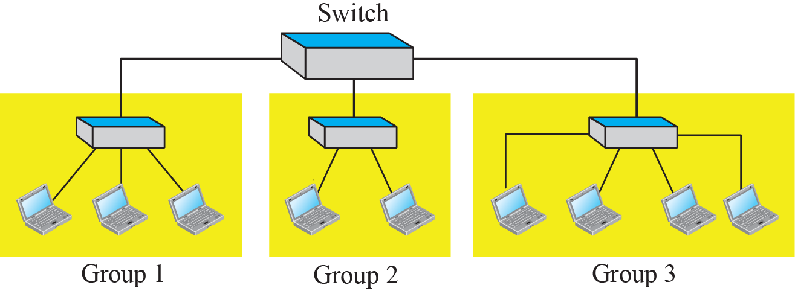
17.2 Virtual LAN
A switch connecting three LANs
What would happen if a member in group 1 move to group 3 to supports group 3.
  Dividing switched LAN into VLAN

Slide 16
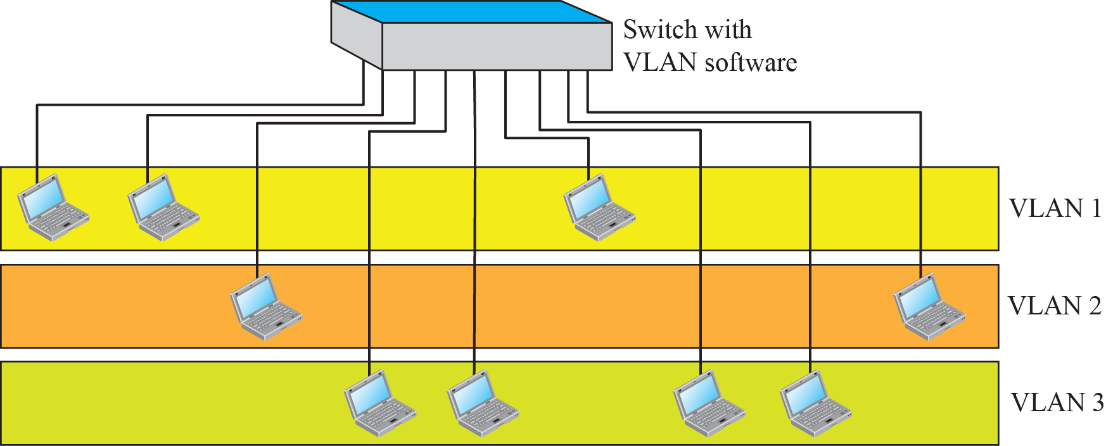
17.2 Virtual LAN
A switch using VLAN software

Slide 17
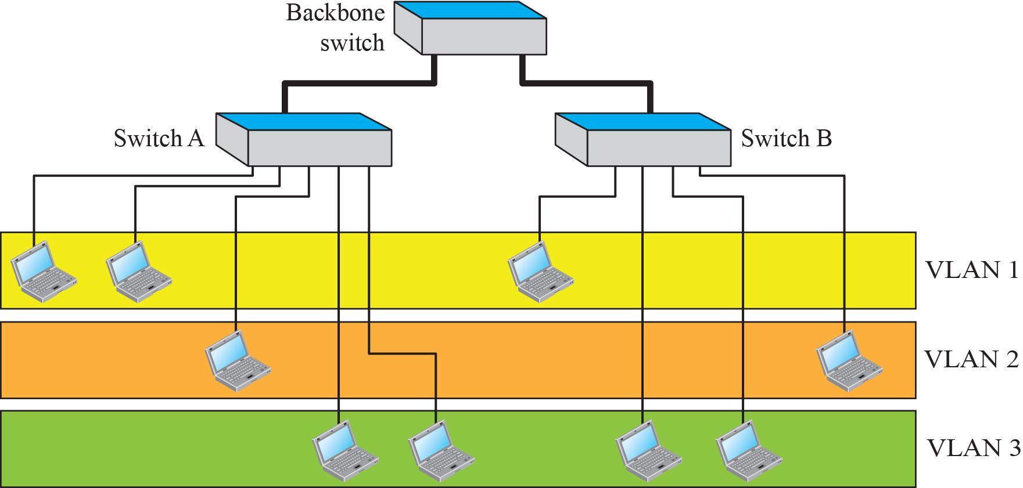
17.2 Virtual LAN
Two switches in a backbone using VLAN software

Slide 18
17.2.1 Membership
What characteristic can be used to group in a VLAN?
  Interface numbers
  Port numbers
  MAC addresses
  IP addresses
  IP multicast addresses
  or a combination of two or more of these.
VLAN Configuraton
  Manually, semi-automatically, automatically

Slide 19
17.2.3 Communication between Switches
In a multi-switched backbone,
  each switch must know not only which station belongs to which VLAN, but also the membership of stations connected to other switches.
Three methods have been devised for this purpose:
  table maintenance, frame tagging, and time-division multiplexing.
VLAN의 장점
  Cost and time reduction
  Creating virtual work groups
  Security

Slide 20
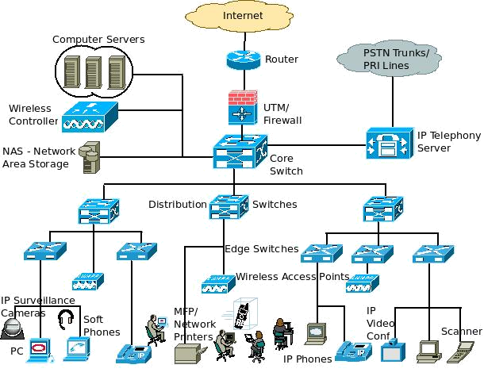
Example of Networking
Switches

Slide 21

17.3 Summary
Connecting Devices
  A Hub is a device that operates only in the physical layer.
  Link-layer Switch operates in both physical and data-link layers.
  A Router is a three-layer device; it operates in the physical, data-link, and network layers.
Virtual LANs (VLAN)
  VLAN is defined as a local area network configured by software, not by physical wiring.

Slide 22
강 의 평 가
1. 나는 이 강의에 적극적으로 참여하였다.
2. 나는 이 강의를 수강하는 동안 충분한 노력을 하였다.
3. 강의계획서는 강의운영에 대한 상세한 정보를 담고 있었다.
4. 교수는 강의계획서에 따라 강의를 진행하였다.
5. 교수는 첫 시간에 강의계획을 명확하게 전달하였다.
6. 교수는 강의 시작 때 항상 수업목표를 통지하였다.
7. 교수는 학생이 강의내용에 흥미를 갖도록 지도하였다.
8. 교수는 강의내용에 대한 전문성을 갖고 있었다.
9. 교수는 학생의 수준을 고려하여 강의내용을 전달하였다.

Slide 23
강 의 평 가
10. 교수는 학습내용의 특성에 맞는 다양한 수업방법을 사용하였다.
11. 교수는 학생의 질문을 유도하고 적절하게 답변하였다.
12. 교수는 강의내용의 심화 및 확대를 위한 과제를 제시하였다.
13. 교수는 학생의 과제 및 평가에 대해 피드백을 제공하였다.
14. 이 강의는 만족스러워 다른 학생에게 추천하고 싶다.
15. 이 강의는 [핵심역량]을 키우는데 도움이 되었다.
16. 교수는 강의내용을 체계적으로 조직하여 설명하였다.
17. 교수는 학습내용의 전달을 위해 목소리의 강약과 완급을
조절하며 설명하였다.

